Slide 1
I/O statements
Java I/O (Input and Output) is used to process the input and produce the output.
The java.io package contains all the classes required for input and output operations.
Java uses the concept of a stream to make I/O operation fast.
A stream is a sequence of data and basically we have 3 types of streams in java
1. System.out – standard output stream
2. System.in -- standard input stream
3. System.err -- standard error stream

Slide 2
System.out: This is the standard output stream that is used to produce the result of a program on an output device like the computer screen.

Slide 3

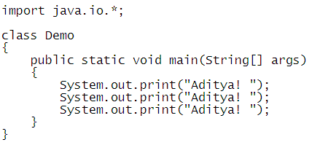
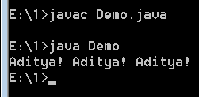
print(): This method in Java is used to display a text or value on the console window.

Slide 4

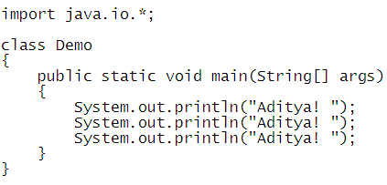
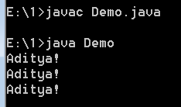
println(): This method in Java is used to display a text or value on the console window.

Slide 5
System.in: This is the standard input stream that is used to read characters from the keyboard or any other standard input device.

Slide 6
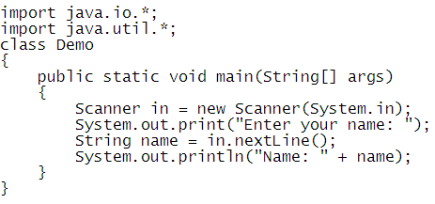
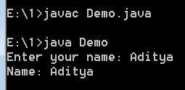

Slide 7
System.err: This is the standard error stream that is used to output all the error data that a program might throw, on a computer screen or any standard output device.
So System.out and System.err both are used to display the output but mostly
System.err is commonly used for error messages in catch block.

Slide 8
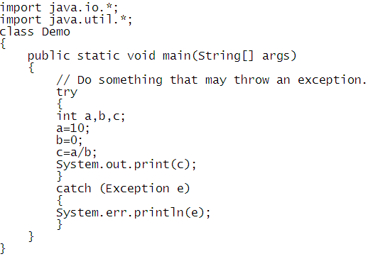
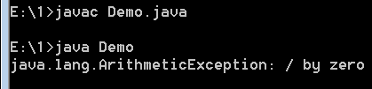

Slide 9
CONDITIONAL STATEMENTS
Decision Making in programming is similar to decision making in real life. In programming also we face some situations where we want a certain block of code to be executed when some condition is fulfilled. A programming language uses control statements to control the flow of execution of program based on certain conditions
TYPES:
1.Simple if
2. If else
3. Nested if
4. If – else – if
5. Switch case

Slide 10
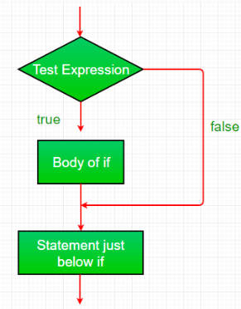
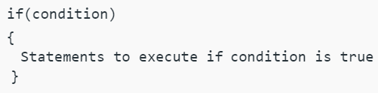
Simple If Statement:
if statement is the most simple decision making statement. It is used to decide whether a certain statement or block of statements will be executed or not i.e if a certain condition is true then a block of statement is executed otherwise not.
Flowchart

Slide 11
Do some examples

Slide 12
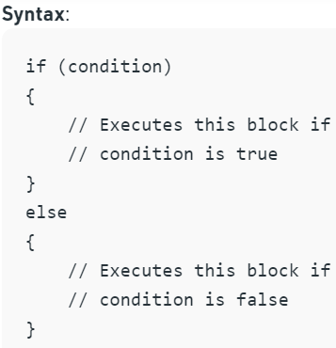
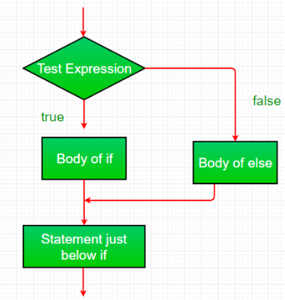
If –else Statement:
The if-else statement have a condition , if the condition is true then if block is executed otherwise else block will be executed.
Flowchart

Slide 13
Do some examples

Slide 14
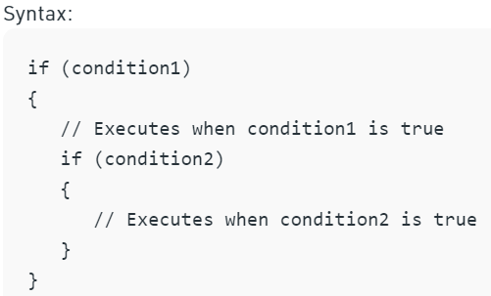
Nested-If –else Statement:
An if statement contains another if statement is called nested if statement. Here the inner if statement is a either simple if (or) if-else .

Slide 15
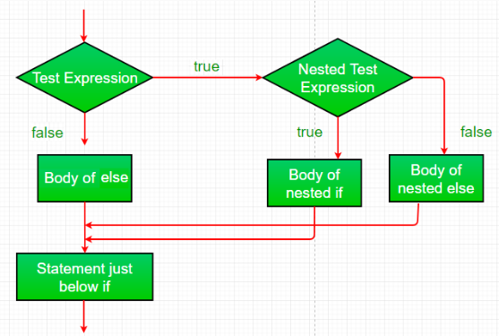
Flowchart

Slide 16
Do some examples

Slide 17
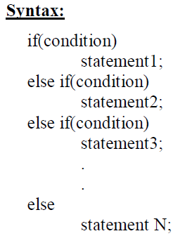
If –else-If Statement:
if-else-if statement is a sequence of if-else statements
In if-else-if ladder if a condition is not met then the control flows from top to bottom until the last if statement.

Slide 18
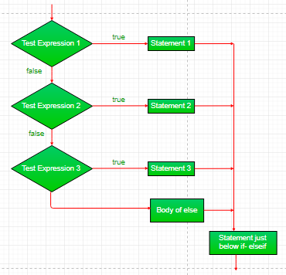
Flowchart

Slide 19
Do some examples

Slide 20
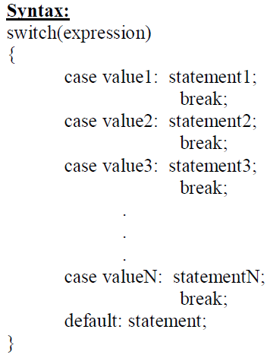
Switch case:
The switch statement is a multiway branch statement. It provides an easy way to dispatch execution to different parts of code based on the value of the expression.

Slide 21
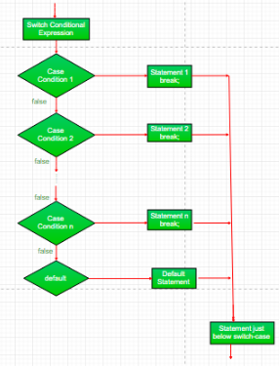
Flowchart

Slide 22
Do some examples

Slide 23
Assignment Programs
Program to find out biggest of four numbers
Program to read a character and print “vowel” or “consonant”
Program on to read a number and print if it is leap year or not
Note : Complete these programs and upload into your github account.

